Slide 1

CSE3251
Computer Networks
Dr. Asif Zaman
Professor, CSE, RU

Slide 2
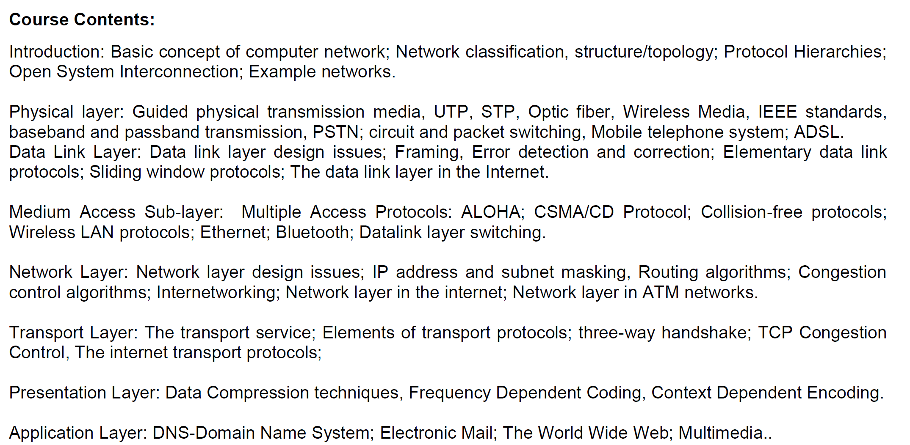

Slide 3
Transport Layer

Slide 4
Responsibilities: Transport Layer
Process to process delivery
End-to-end Connection between hosts
Multiplexing and Demultiplexing
Congestion Control
Data integrity and Error correction
Flow control

Slide 5
Transport Layer
Various responsibilities of a Transport Layer –
Process to process delivery
End-to-end Connection between hosts
Multiplexing and Demultiplexing
Congestion Control
Data integrity and Error correction
Flow control

Slide 6
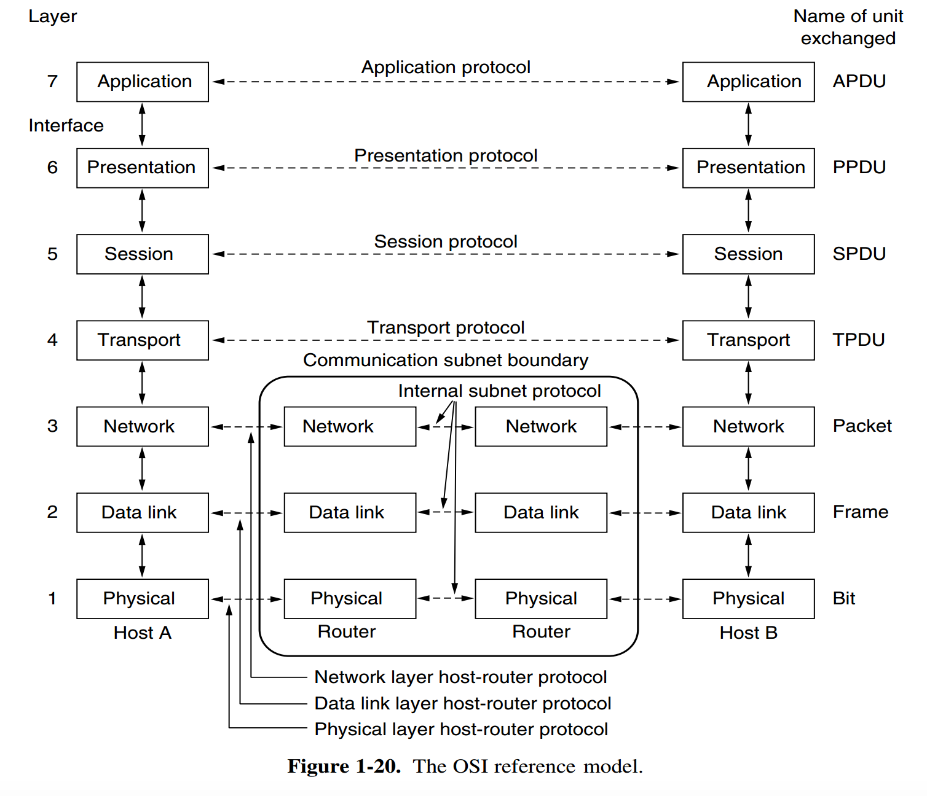
Process to process delivery
16bit Port Number
IP Address 32bit
MAC Address 48bit

Slide 7
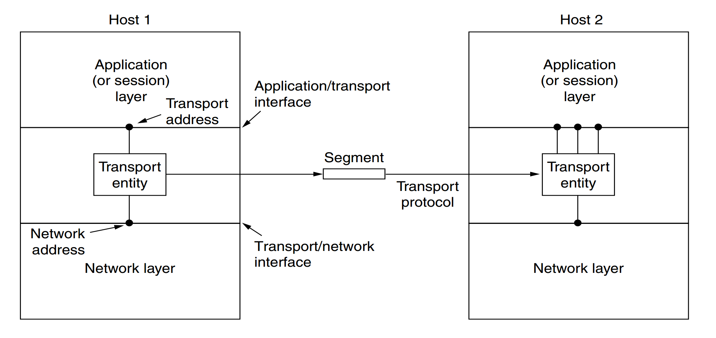
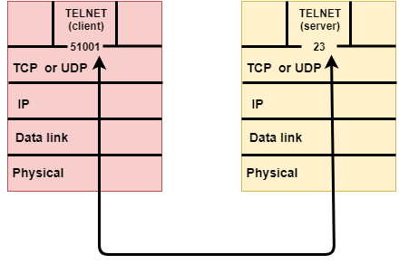
Process to process delivery

Slide 8
Transport Layer
Various responsibilities of a Transport Layer –
Process to process delivery
End-to-end Connection between hosts
Multiplexing and Demultiplexing
Congestion Control
Data integrity and Error correction
Flow control

Slide 9
End-to-end Connection between hosts
Two types of connection:
Connection oriented
Connectionless
TCP –Transmission Control Protocol
UDP – User Datagram Protocol

Slide 10
End-to-end Connection between hosts
Transmission Control Protocol (TCP)
Transmission Control Protocol (TCP) is a connection oriented protocol,
… the devices should open a connection before transmitting data and should close the connection gracefully after transmitting the data.
… assure reliable delivery of data to the destination.
… protocol provides extensive error checking mechanisms such as flow control and acknowledgment of data.

Slide 11
End-to-end Connection between hosts
Sequencing of data is a feature of Transmission Control Protocol (TCP).
Delivery of data is guaranteed if you are using Transmission Control Protocol (TCP).
Transmission Control Protocol (TCP) is comparatively slow because of these extensive error checking mechanism.
Multiplexing and Demultiplexing is possible in Transmission Control Protocol (TCP) using TCP port numbers.
Retransmission of lost packets is possible in Transmission Control Protocol (TCP)

Slide 12
Features Of TCP protocol?
Stream data transfer
Reliability
Flow Control
Multiplexing
Logical Connections
Full Duplex
https://www.tpointtech.com/computer-network-transport-layer-protocols

Slide 13
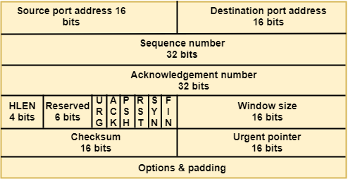
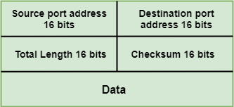
https://www.tpointtech.com/computer-network-transport-layer-protocols

Slide 14
End-to-end Connection between hosts
User Datagram Protocol (UDP)
User Datagram Protocol (UDP) is Datagram oriented protocol with no overhead for opening a connection (using three-way handshake), maintaining a connection, and closing (terminating) a connection.
User Datagram Protocol (UDP) is efficient for broadcast/multicast type of network transmission.
User Datagram Protocol (UDP) has only the basic error checking mechanism using checksums.

Slide 15
End-to-end Connection between hosts
There is no sequencing of data in User Datagram Protocol (UDP).
The delivery of data cannot be guaranteed in User Datagram Protocol (UDP).
User Datagram Protocol (UDP) is faster, simpler and more efficient than TCP. However, User Datagram Protocol (UDP) it is less robust then TCP.
Multiplexing and Demultiplexing is possible in User Datagram Protocol (UDP) using UDP port numbers.
There is no retransmission of lost packets in User Datagram Protocol (UDP).

Slide 16
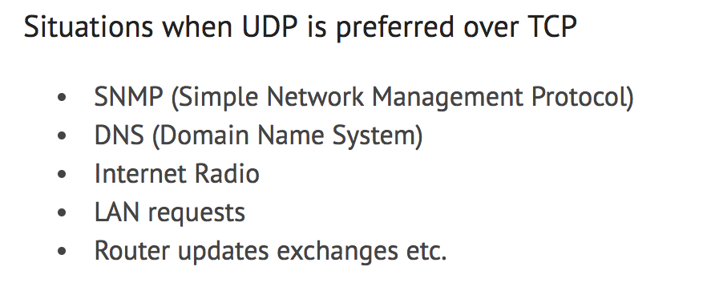
End-to-end Connection between hosts

Slide 17
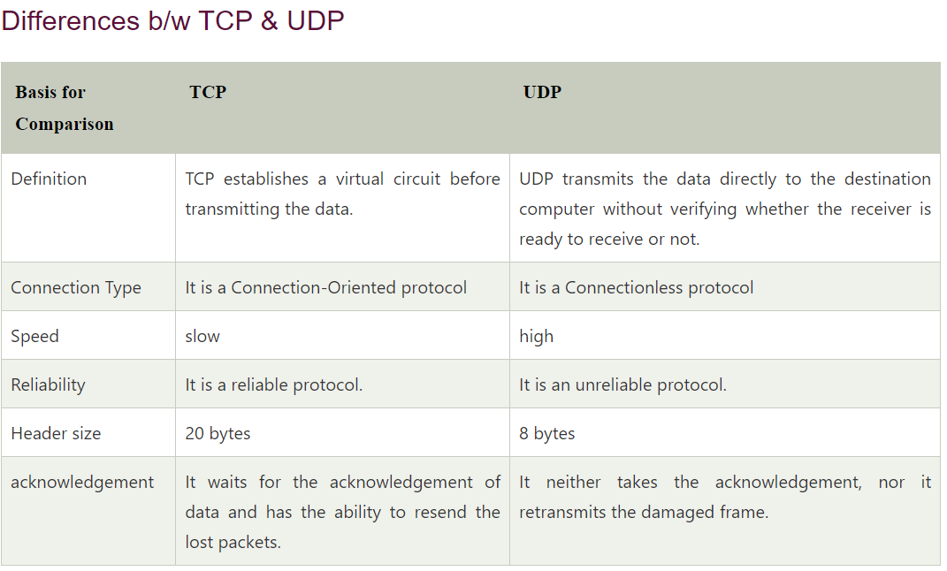

Slide 18
Transport Layer
Various responsibilities of a Transport Layer –
Process to process delivery
End-to-end Connection between hosts
Multiplexing and Demultiplexing
Congestion Control
Data integrity and Error correction
Flow control

Slide 19
Multiplexing and Demultiplexing
Multiplexing allows simultaneous use of different applications over a network which are running on a host.

Slide 20
Transport Layer
Various responsibilities of a Transport Layer –
Process to process delivery
End-to-end Connection between hosts
Multiplexing and Demultiplexing
Congestion Control
Data integrity and Error correction
Flow control

Slide 21
Congestion Control
Congestion – over crowding
Congestion is a situation in which too many sources over a network attempt to send data and the router buffers start overflowing due to which loss of packets occur.
As a result retransmission of packets from the sources increase the congestion further

Slide 22
Transport Layer
Various responsibilities of a Transport Layer –
Process to process delivery
End-to-end Connection between hosts
Multiplexing and Demultiplexing
Congestion Control
Data integrity and Error correction
Flow control

Slide 23
Transport Layer
Transport layer checks for errors in the messages coming from application layer by using error detection codes, computing checksums, it checks whether the received data is not corrupted and uses the ACK and NACK services to inform the sender if the data is arrived or not and checks for the integrity of data.
…fast sender and slow receiver

Slide 24
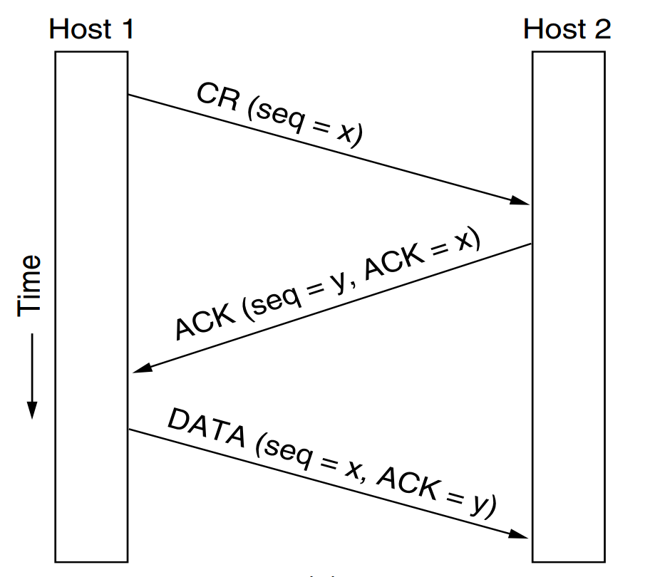
TCP Connection Establishing
Three way handshake

Slide 25
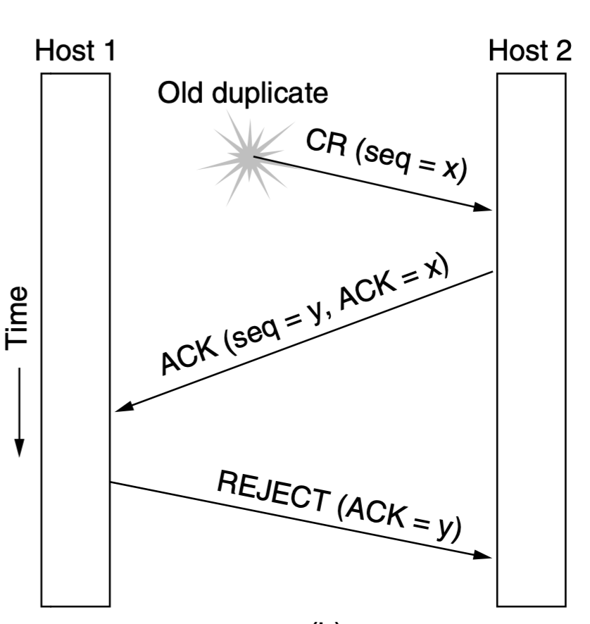
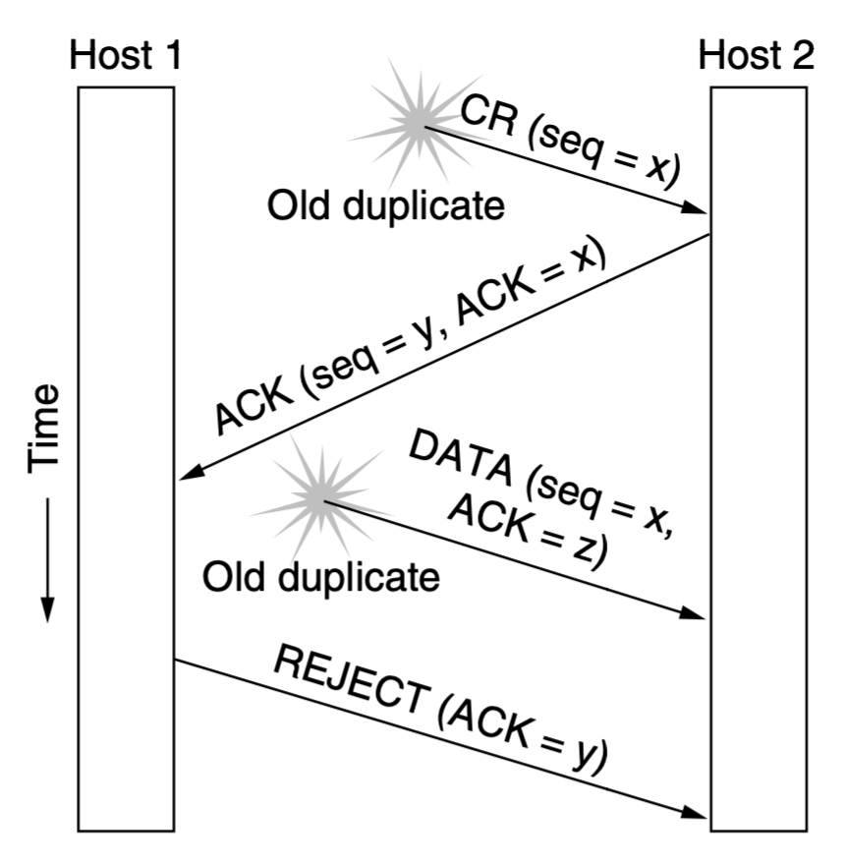
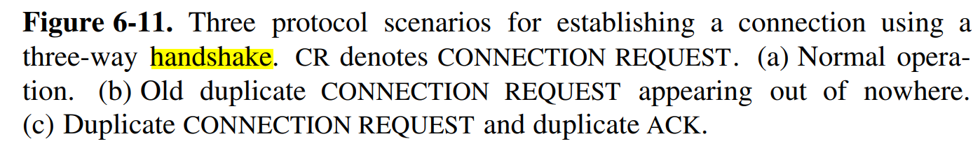
TCP Connection Establishing
Three way handshake

Slide 26
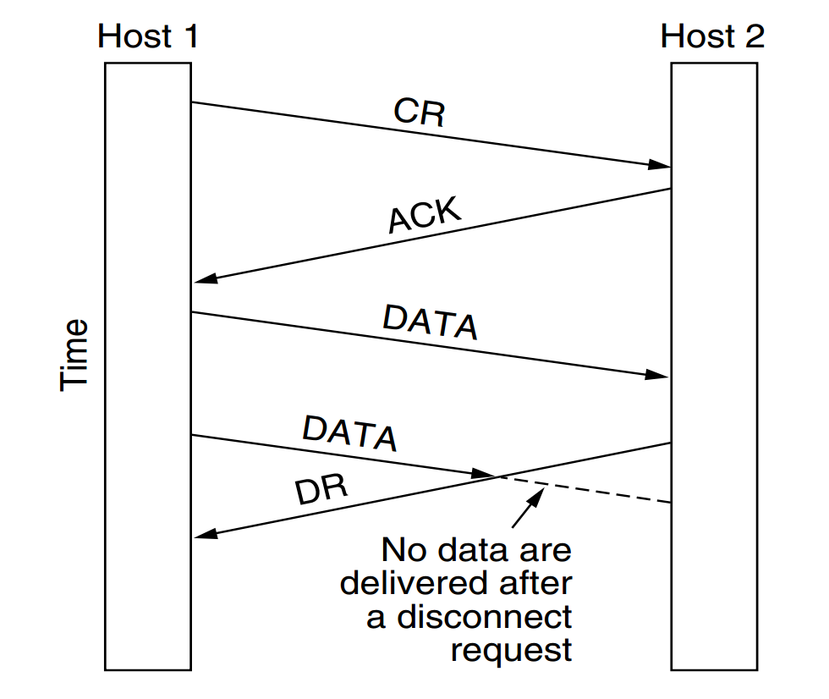
TCP Connection Release

Slide 27
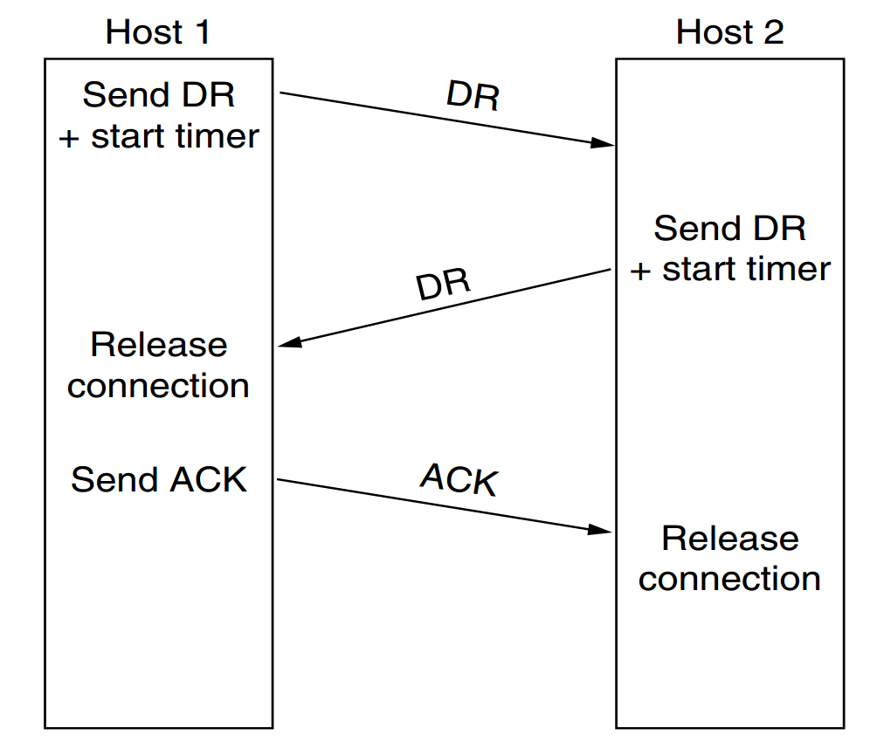
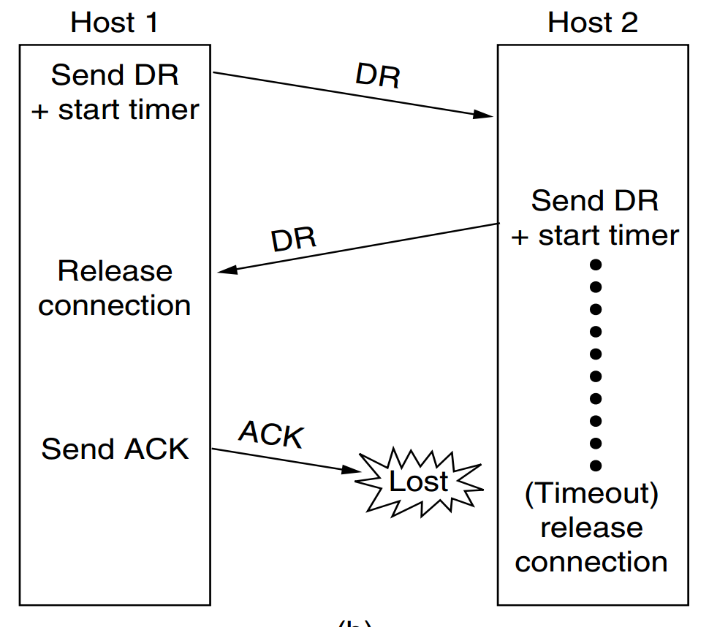
TCP Connection Release

Slide 28
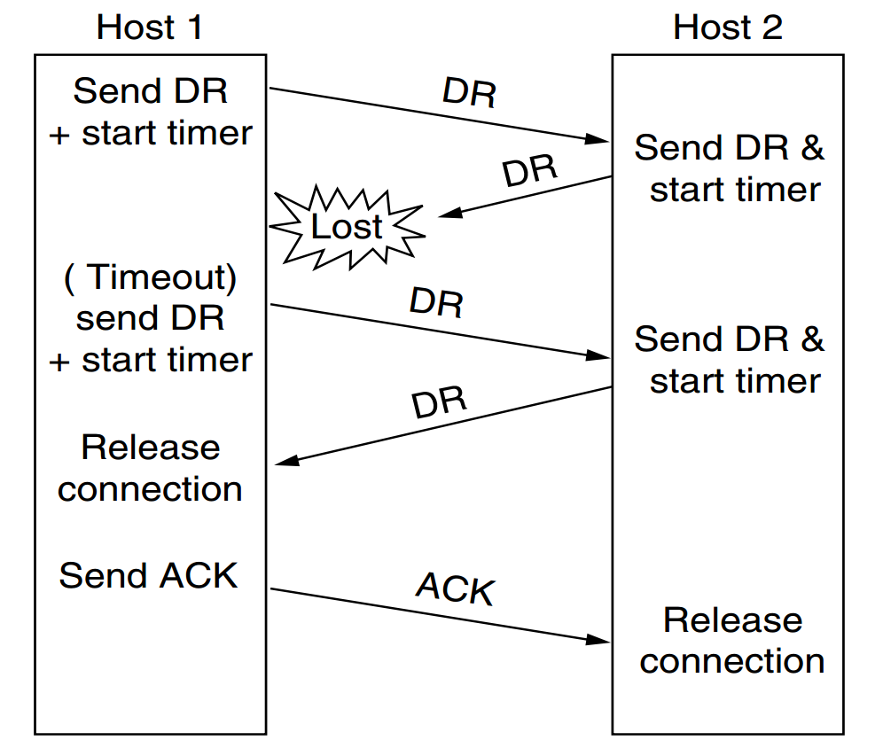
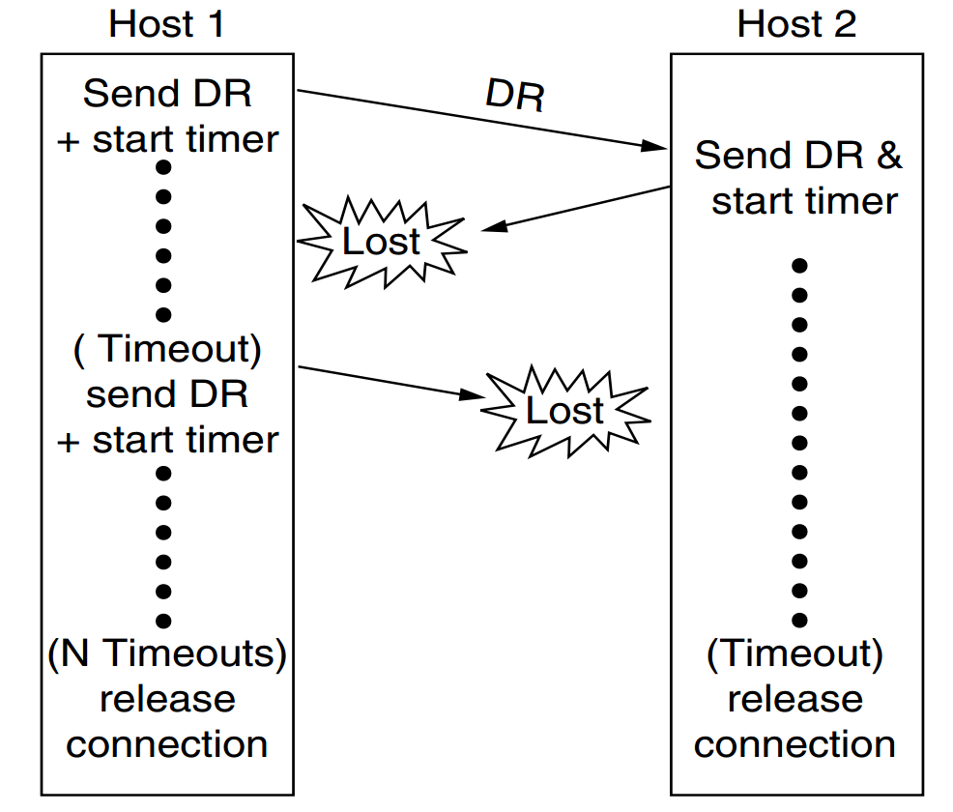
TCP Connection Release

